Slide 1
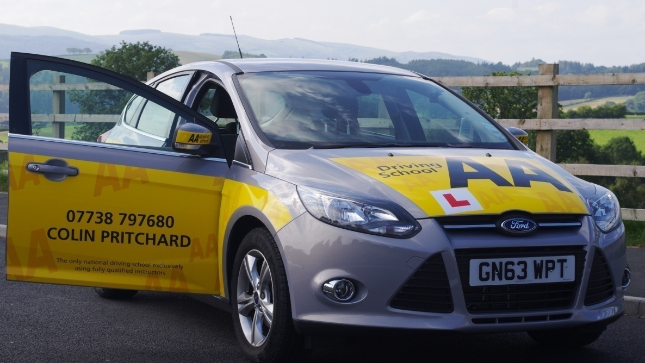
Colin Pritchard Driving School
Customer Satisfaction Survey Results
Last Updated 1st January 2014

Slide 2
The following shows the responses I have received from my clients on finishing their last lesson with me. At the time of last updating I had 94 completed surveys.
Customers have been asked to rate the service they have received , running from Poor, Average, Good and Excellent.
The first questions were in connection with the tuition vehicle.
Q1. How would you rate the exterior cleanliness of the vehicle for each lesson?

Slide 3
Q2. How would you rate the interior cleanliness of the vehicle for each lesson?
Q3. How did you find the Ford Focus 1.6 Zetec to be a good car to learn your driving skills in?

Slide 4
The next questions all concern my students opinion of my teaching/coaching abilities
Q1. Was your instructor punctual for all lessons?
Q2. Was your instructor well presented for all lessons?

Slide 5
The next questions all concern my students opinion of my teaching/coaching abilities (Cont.)
Q3. Did your instructor use appropriate communication methods?
Q4. Were you happy with the pace of progress you made?

Slide 6
The next questions all concern my students opinion of my teaching/coaching abilities (Cont.)
Q4. Were you happy with the pace of progress you made?
Q5. Did you feel your instructor was knowledgeable in the subject of Driving Instruction?

Slide 7
The next questions all concern my students opinion of my teaching/coaching abilities (Cont.)
Q6. How would you rate your instructor’s professionalism?
Q7. Would you recommend your instructor to a friend?
The 1 no comment was actually a “Don’t Know”

Slide 8
The final questions cover various miscellaneous issues.
Q1. How would you rate your lessons in terms of Value for Money?
Q2. Did your instructor make your lessons enjoyable?

Slide 9
I also asked for responses to the question “Could you please think of one issue that satisfied you the most during your instruction?” Responses include:
Friendly & relaxed instructor made lessons enjoyable and less stressful.
Lessons were tailored to my personal needs as a student
The encouragement, although everything was brilliant
Getting my confidence up while driving the car
Picking up from work and dropping off at home
Very polite in pointing out my few mistakes!
Teaching of bay parking

Slide 10
I also asked for responses to the question “Could you please think of one issue that satisfied you the most during your instruction?” (Cont.)
Responses include:
Lessons were tailored for my personal needs as a student
The encouragement, though everything was brilliant
My instructor was very friendly and made me feel at ease when I made mistakes! I learnt to drive quickly and easily and enjoyed it too.
Patient and clear communication of driving instruction. Encouraging, also letting me know what I needed to improve!
Clarity of the lessons and direction

Slide 11
I also asked for responses to the question “Could you please think of one issue that satisfied you the most during your instruction?” (Cont.)
Responses include:
Colin made you relaxed and taught you very well and explained in detail.
I always felt safe and secure, very positive about my driving.
Instructor being friendly and understanding.
Put me at ease with nerves
Lessons were fast learning, value for money and enjoyable
Good at calming me down and communicating

Slide 12
I also asked for responses to the question “Could you please think of one issue that satisfied you the most during your instruction?” (Cont.)
Responses include:
I passed! Honest also didn't give lessons when not needed i.e. before I had done theory.
He found an easy way to solve a problem
How nice and friendly my instructor was.
Colin was really nice when I failed, helped cheer me up.
I liked the fact that my parents could come out with us as it allowed them to gain a better idea of how I was being taught.

Slide 13
I also asked for responses to the question “Could you please think of one issue that satisfied you the most during your instruction?” (Cont.)
Responses include:
Very clear driving instruction, very patient.
We were always talking about useful information and I never felt uncomfortable.
Colin was the first instructor to make me feel comfortable (I have had 4!).
He listened to me.
Lessons worked well and fitted around me.
Attention to detail, friendly encouragement.

Slide 14
I also asked for responses to the question “Could you please think of one issue that satisfied you the most during your instruction?” (Cont.)
Responses include:
Great communication between teacher and pupil.
Positive reinforcement as well as criticism.
Sense of humour puts one at ease.
I needed to have my confidence built and he was positive with his comments when I did things well.
The unerring ability to arrive before my lesson and put his instructions

Slide 15
I also asked for responses to the question “Could you please think of one issue that satisfied you the most during your instruction?” (Cont.)
Responses include:
The unerring ability to arrive before my lesson and put his instructions into context making them easy to understand.
I have enjoyed every lesson and I would recommend Colin to my friends.

Slide 16
I also asked for responses to the question “Could you please think of one issue that dissatisfied you the most during your instruction?”
Comments Include:
The cost. Not keeping the car!
Finding the manouevres hard
My self confidence
Trouble booking available spots.
The reverse gear sometimes "jumped" out.
Gear box.
Air conditioning could have been colder

Slide 17
I also asked for responses to the question “Could you please think of one issue that dissatisfied you the most during your instruction?”
Comments include:
Would have liked to take test earlier.
Maybe earlier to arrive, some times earlier than I was expecting.

